Slide 1
Introduction to RTX Kernel
Event Flags

Slide 2
Event Handling and Flag Register
os_evt_set: Sets one or more event flags of a task.
os_evt_wait_and :Waits for one or more event flags to be set.
os_evt_wait_or: Waits for one or more event flags to be set.
RTOS LAB

Slide 3
os_evt_set
This function sets the event flags for the task identified by the function argument.
The function only sets the event flags whose corresponding bit is set to 1 in the event_flags argument.
Syntax
Ex :os_evt_set (0x0003, tsk2);
void
os_evt_set
(
event_flags,
OS_TID task
);
RTOS LAB

Slide 4
os_evt_wait_or
This function waits for one of the events specified in the wait_flags to occur.
The function only waits on events whose corresponding flags have been set to 1 in the wait_flags parameter.
The function can wait on as many as 16 different events.
Syntax
OS_RESULT
os_evt_wait_or
(
U16 wait_flags,
timeout
);
RTOS LAB

Slide 5
os_evt_wait_and
This function waits for all the events specified in the wait_flags to occur
Syntax
OS_RESULT
os_evt_wait_and
(
U16 wait_flags,
);
timeout
RTOS LAB

Slide 6
Return Value Description
OS_R_EVT--At least one of the flags specified by wait_flags has been set.
OS_R_TMO-- The timeout has expired.
RTOS LAB

Slide 7
System
Task-1
Sets an EVENT FLAG
Task-2
Waits for an EVENT FLAG
RTOS LAB

Slide 8
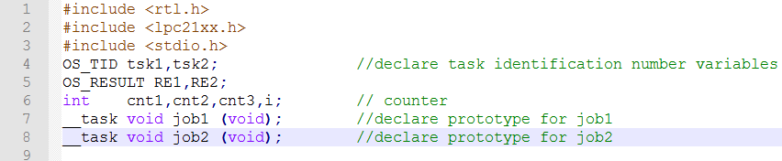
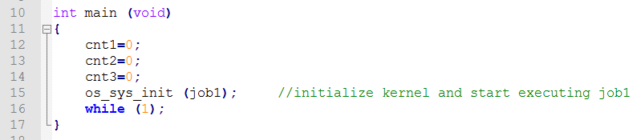
RTOS LAB

Slide 9
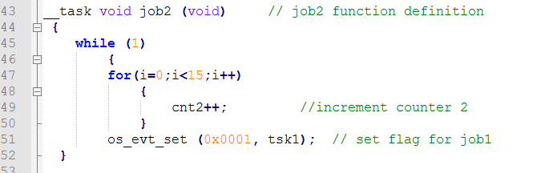
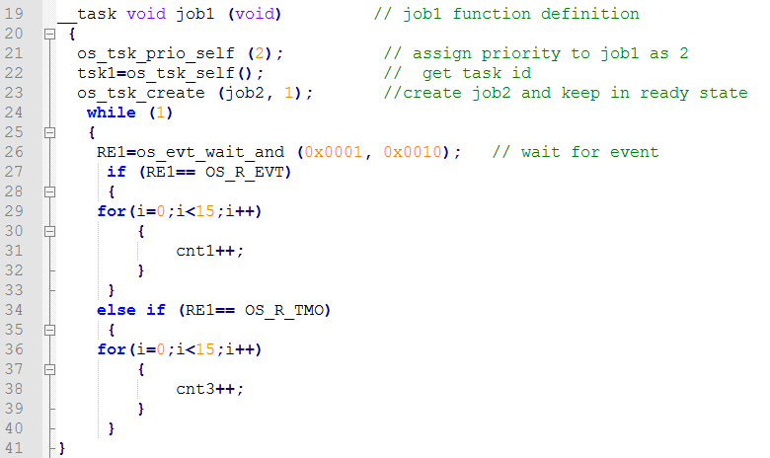
RTOS LAB

Slide 10

Thank you
RTOS LAB

